Slide 1
Part 1 Legislation and Regulatory Contexts
Lomas & Almeida 2021

Slide 2
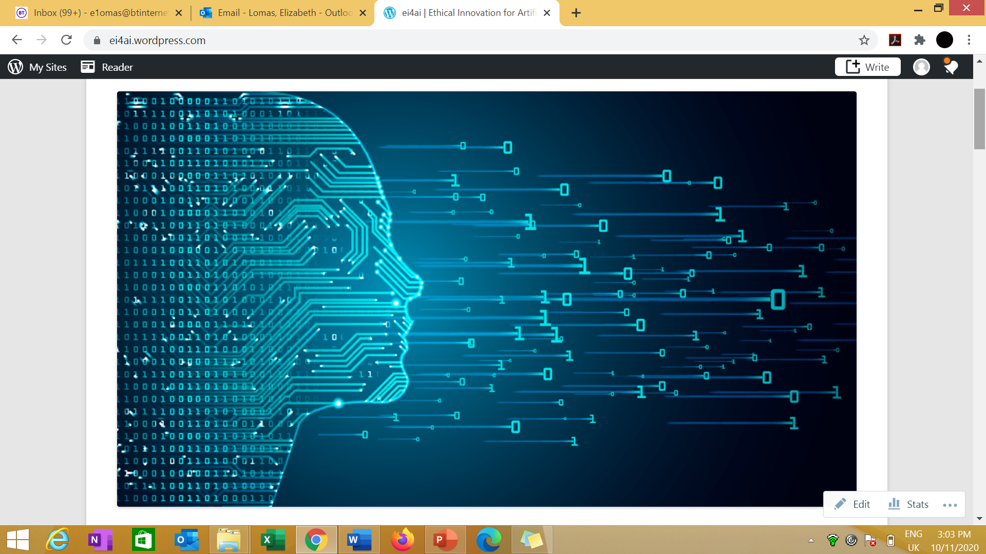
Ethical and Compliant AI Innovation
Developed
Deployed
User/end user
Location
Data/Data banks/lakes accrual
Purpose
Proportionality
Models
Accountability
Explainability
Challenge
Legal Responsibilities
Ethical Innovation for Artificial Intelligence
https://ei4ai.wordpress.com/
Lomas & Almeida 2021
Notes:
Data is the new oil!
OR
Good quality data, ethically and appropriately used is like the flow of water?

Slide 3

Global Legislative Contexts
Multiple jurisdictions and perspectives add to the complexity of compliance:
United Nations
European Union
UK
Canada
USA
China
India
Local/State
Lomas & Almeida 2021

Slide 4
Legislation and Societal Context
Society
Courts
Individual
Regulators
Intersection of:
Legislation
Case law
Regulators
Best practice
Public versus Private Law
Differing evidential standards
Warfare
Lomas & Almeida 2021

Slide 5

Risk Management
Legislation
Prescriptive- thou shalt
Balancing competing considerations
Avoiding negative impacts
Impact of Breaches
Financial
Harm
Damage
Providing for rights and freedoms
Lomas & Almeida 2021

Slide 6

Human Rights as a Foundation
Universal Declaration of
Human Rights - 1948
Article 7 – all equal before the law
Article 12 – right to privacy
Article 17 – right to property
Article 18 – right to freedom
of thought
Article 19 – right to freedom
of expression
Article 27 - right to the protection
of the moral and material interests
resulting from any scientific,
literary or artistic production
This Photo by Unknown Author is licensed under CC BY-NC-ND
Lomas & Almeida 2021

Slide 7
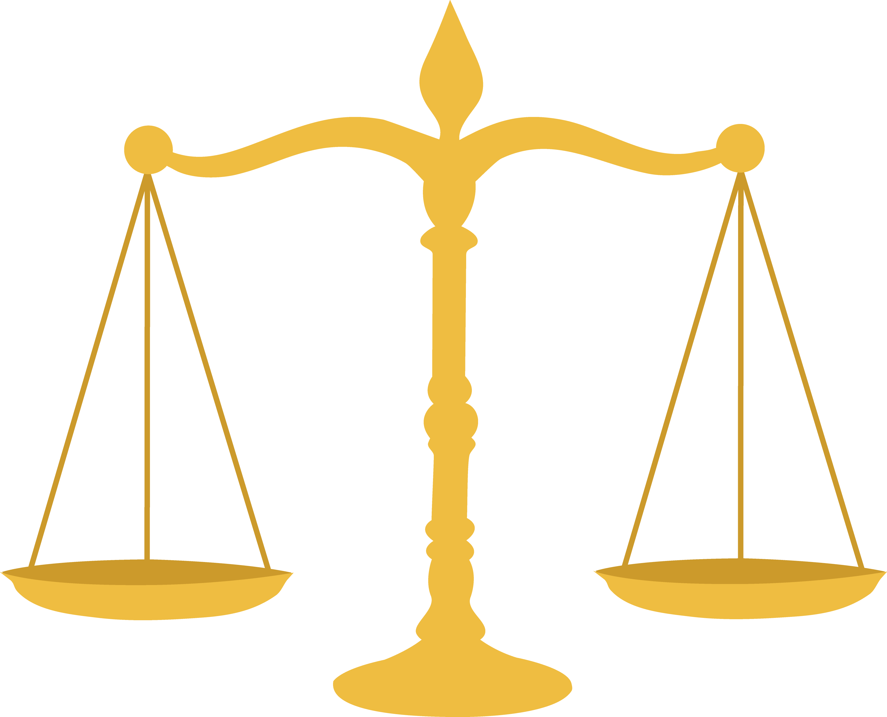
Equality, Diversity and Inclusion
EU Charter of Fundamental Rights (Article 21) UK Equality Act 2010 USA Civil Rights Act
Protected Characteristics
Age, Disability, Gender Reassignment, Marriage and Civil Partnership, Pregnancy and maternity, Race, Religion or Belief, Sex, Sexual orientation, Genetics, Language.
Direct, Indirect, Associative, Perceptive Discrimination
This Photo by Unknown Author is licensed under CC BY-NC
Lomas & Almeida 2021

Slide 8
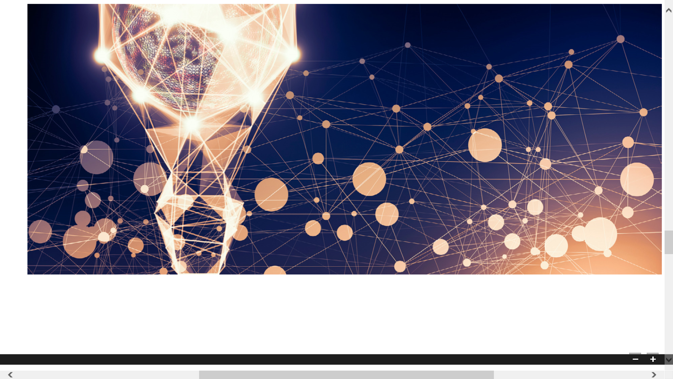
Intellectual Property Rights
-Patents
-Industrial Design
-Trade secrets and ‘know how’
-Trade Marks
-Brand
-Copyright – needs human creator
-Digital Rights Management
-Software, Database Rights etcs
Legislated for in different ways
Last for different times
Differ internationally
Lomas & Almeida 2021
Notes:
Patents 20 years Trade marks renew every 10 years.
Industrial Design – registered design
Presenting your work at trade shows/conferences/exhibitions could be a disclosure.
•Leaving your work unattended or on white boards.
•Discussing sensitive information in public areas.
•Store your confidential information securely.
•Ensure those who you do disclose to agree to and understand your confidentiality.
•If you do need to talk to 3rd parties about your work – WHAT do you actually need to tell them? (can you get the message across without disclosing the confidential information?).
https://www.open.edu/openlearn/ocw/pluginfile.php/801396/mod_resource/content/3/Session%206%20WIPO%20What%20is%20intellectual%20property%20booklet.pdf#:~:text=An%20industrial%20design%20refers%20to,as%20patterns%2C%20lines%20or%20color.

Slide 9
Intellectual Property Rights
Provides for:
- Control
- Collaboration Frameworks
- Commoditization
- Monopolies
- Protection
Software is protected by copyright law – provides paternity and moral rights
Fair Dealing vs Fair Use
Inventions related to software are protected by patents
Trade secrets – contracts/NDAs
Lomas & Almeida 2021
Notes:
Patents 20 years Trade marks renew every 10 years.
Industrial Design – registered design
Presenting your work at trade shows/conferences/exhibitions could be a disclosure.
•Leaving your work unattended or on white boards.
•Discussing sensitive information in public areas.
•Store your confidential information securely.
•Ensure those who you do disclose to agree to and understand your confidentiality.
•If you do need to talk to 3rd parties about your work – WHAT do you actually need to tell them? (can you get the message across without disclosing the confidential information?).
https://www.open.edu/openlearn/ocw/pluginfile.php/801396/mod_resource/content/3/Session%206%20WIPO%20What%20is%20intellectual%20property%20booklet.pdf#:~:text=An%20industrial%20design%20refers%20to,as%20patterns%2C%20lines%20or%20color.

Slide 10

World Intellectual Property Organisation
“Our mission is to lead the development of a balanced and effective international IP system that enables innovation and creativity for the benefit of all. Our mandate, governing bodies and procedures are set out in the WIPO Convention, which established WIPO in 1967.”
https://www.wipo.int/about-wipo/en/
This Photo by Unknown Author is licensed under CC BY-SA
Lomas & Almeida 2021

Slide 11
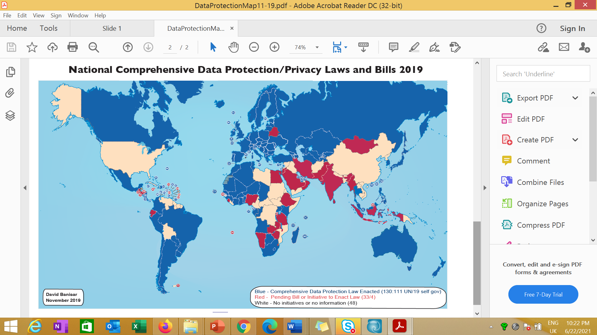
Privacy and Personal Data: Mapping of information privacy regimes
This image is produced with permission of David Banisar. See https://www.researchgate.net/publication/337060085_National_Comprehensive_Data_ProtectionPrivacy_Laws_and_Bills_-_November_2019
Lomas & Almeida 2021

Slide 12
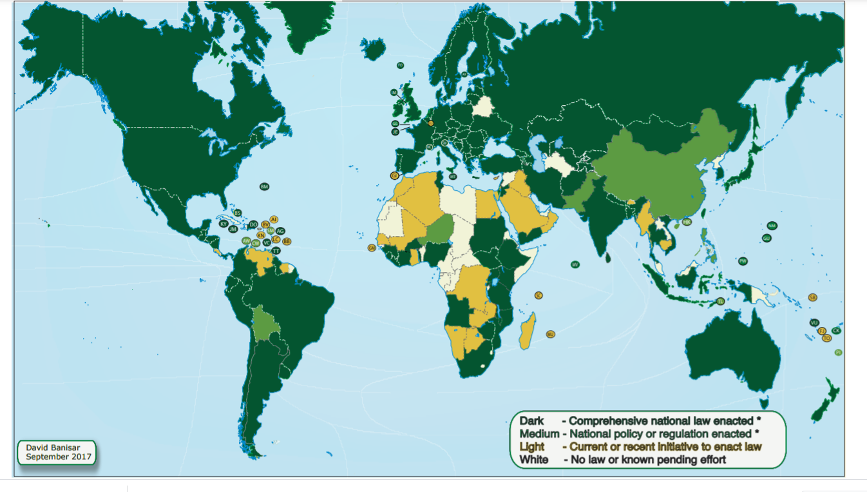
Mapping of information access regimes
This image is produced with permission of David Banisar. See https://www.researchgate.net/publication/256010224_National_Right_to_Information_Laws_Regulations_and_Initiatives_2017_Map
Lomas & Almeida 2021

Slide 13
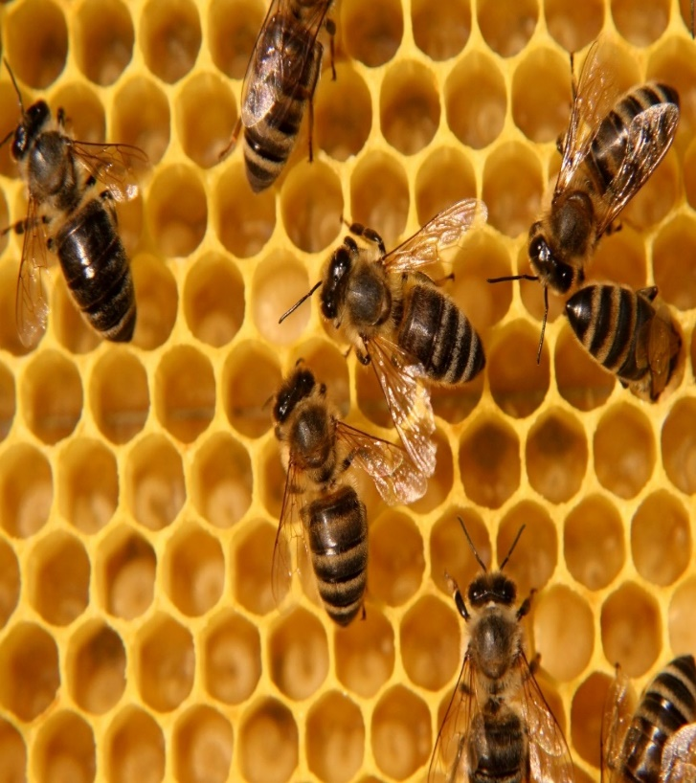
Activity: Mapping out the legislative and regulatory landscape
To map out the legislative context either for your organization or an organization you are familiar with. Consider:
What is the broad legislative context?
Who are the regulators?
How/where/why might AI be developed/deployed?
Who are the stakeholders?
What could be the benefits of AI in this context?
What might be the risks taking into account any issues around potential harm or damage or rights infringements?
Lomas & Almeida 2021

Slide 14
Part 1 - Readings
Read Chapter 3 on ‘Who bears responsibility for the threats, risks, harms and wrongs posed by advanced digital technologies?’, in Yeung, K. ed. (2019) Responsibility and AI: a study of the implications of advanced digital technologies (including AI systems) for the concept of responsibility within a human rights framework. Strasbourg: Council of Europe. Available at: https://rm.coe.int/responsability-and-ai-en/168097d9c5 (Accessed 1 July 2021)
Lomas & Almeida 2021

